Slide 1
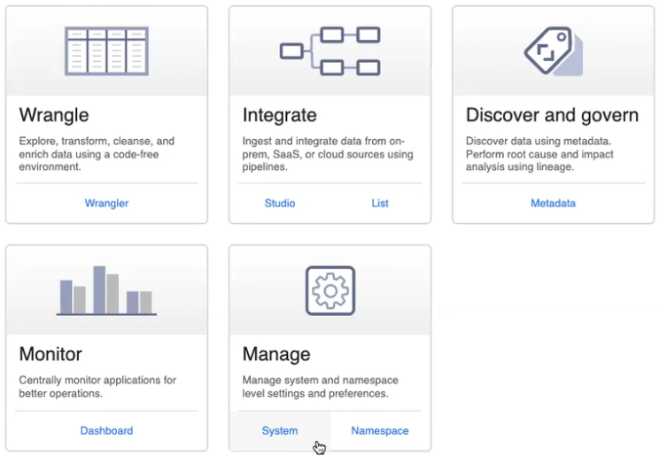
Data Fusion
Forma Gráfica de trabalhar com o Spark
Accelerator Replication: CDC from production into Analytics data warehouse
Accelerator CCAI Insights: bulk load
Instanciado, Dataproc como infraestrutura
Permite criar pipeline de stream

Slide 2
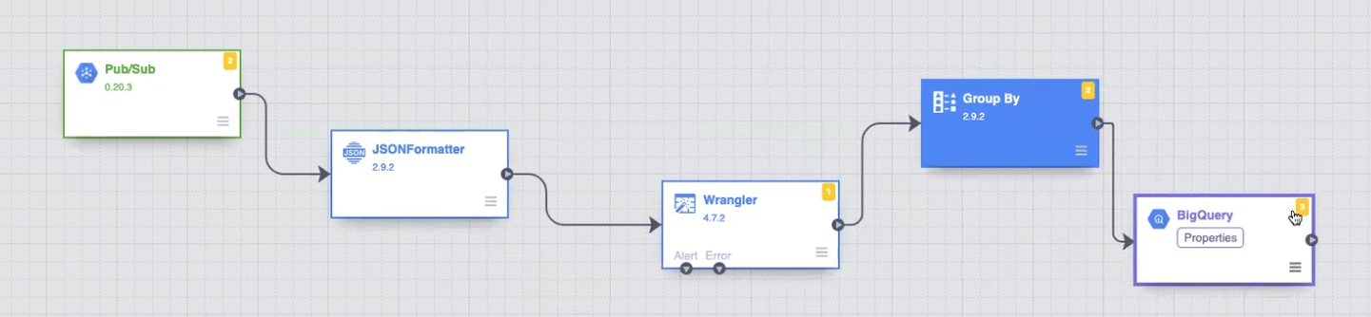
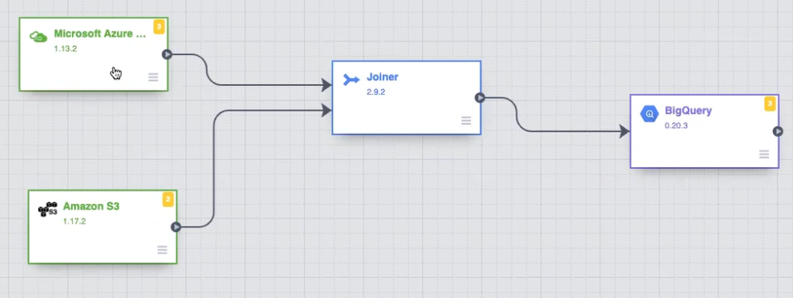
Data Fusion

Slide 3
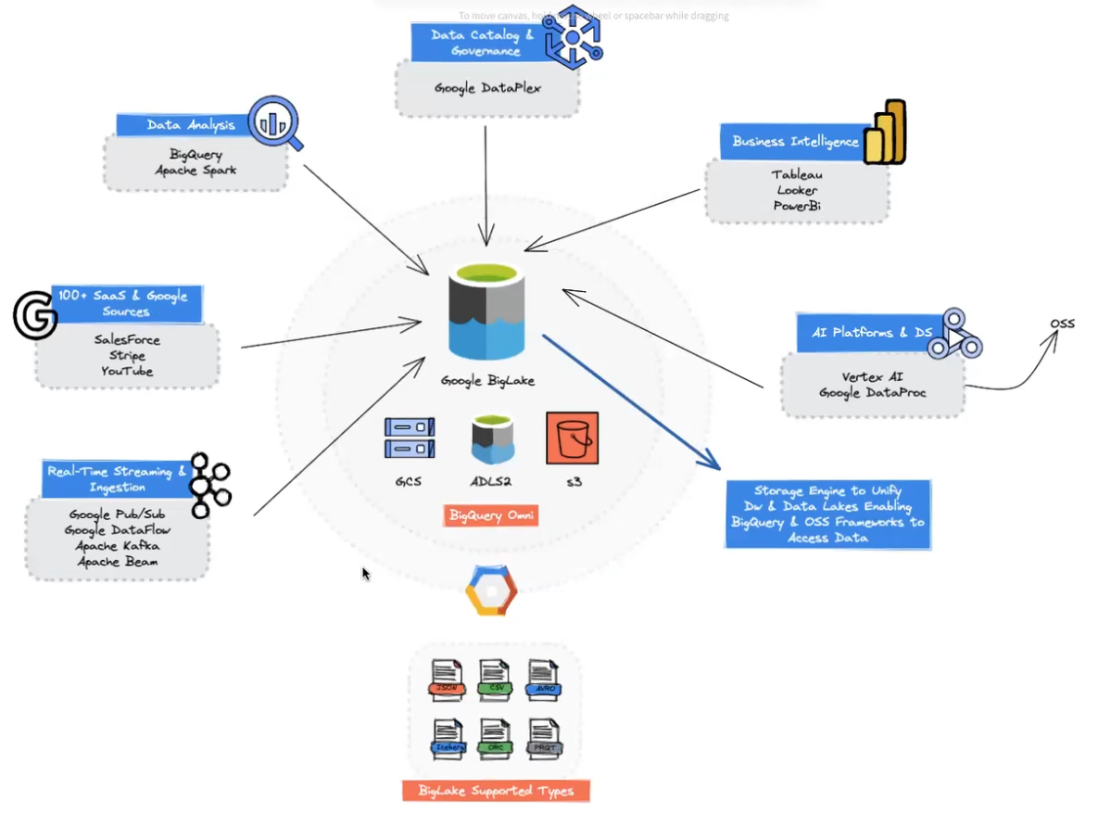
BigLake

Slide 4
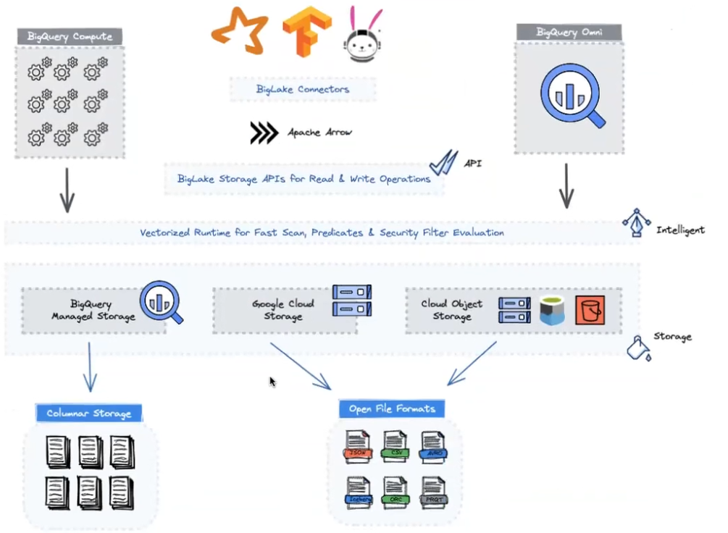
BigLake

Slide 5
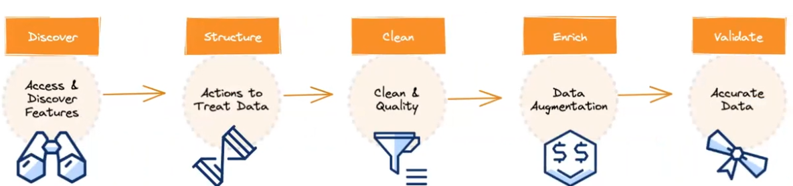
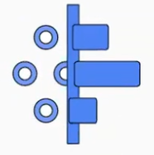
DataPrep
Data exploration or Data Wrangling is a self-service activity to Access, Assess, and Covert Raw, messy data into a clean, view to your Analytics and Data Science needs
Uses Dataflow & BigQuery Under the hood
Designed for simplicity using a Serveless Enviroment
Easy & Powerful Data Preparation
Fast Exploration & Anomaly Detection
PowerQuery do GCP
Apache Nifi do GCP

Slide 6
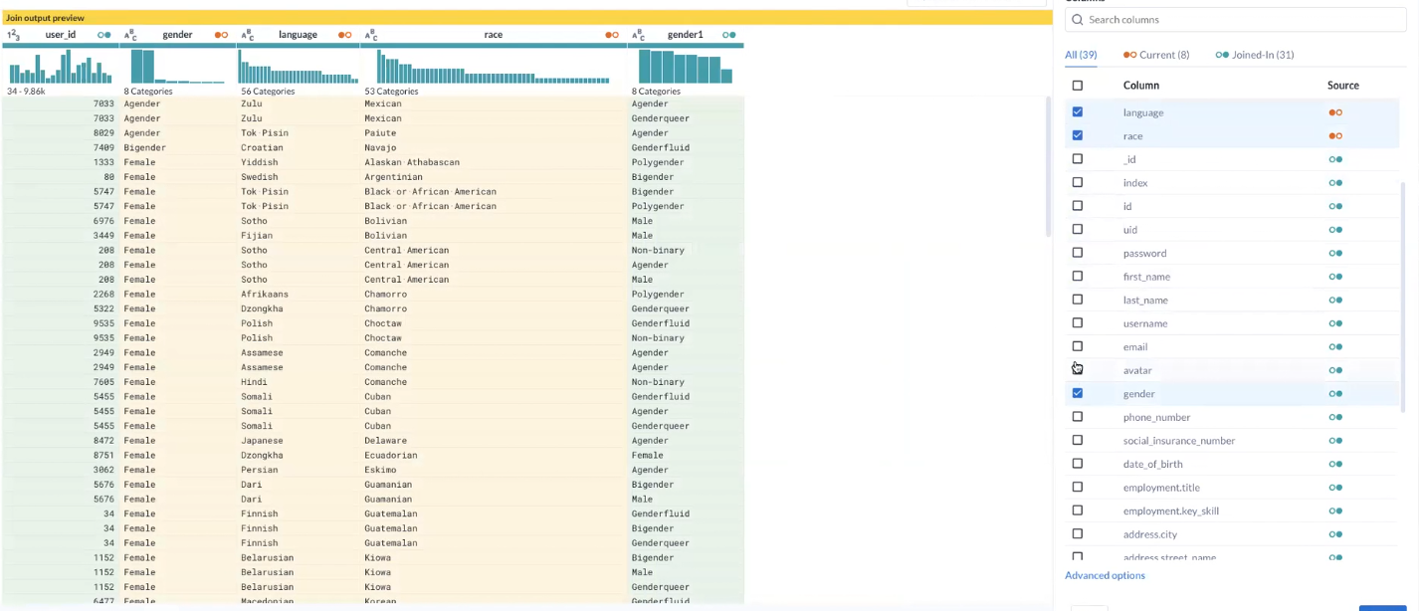
DataPrep
Cloud Storage como staging
Give suggestion of data wraggling
Scale with Dataflow

Slide 7
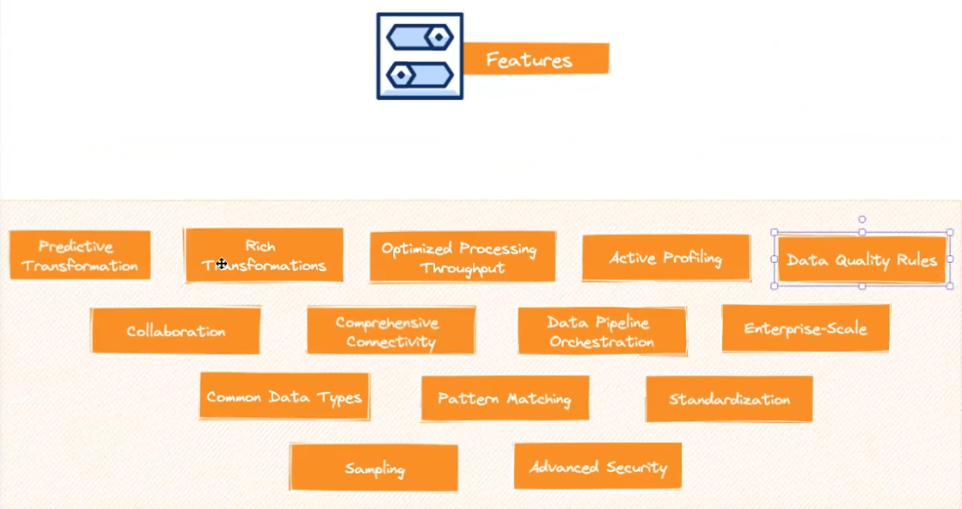
DataPrep

Slide 8
DataProc
Kubernetes (90s for provisioning)
Managed and high scalable
Same as Azure HDInsight, Amazon EMR
Possui Zeppelin e Jupyter para desenvolvimento via notebook
Possui Serveless para Batch

Slide 9
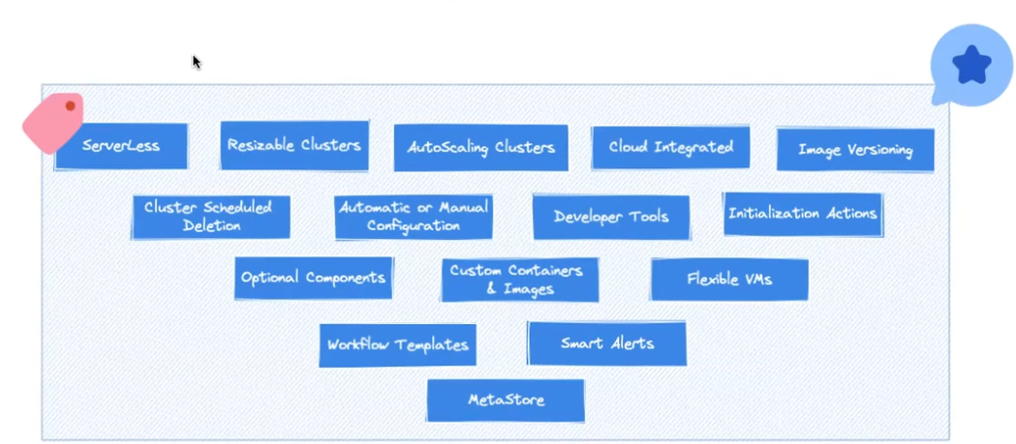
DataProc

Slide 10
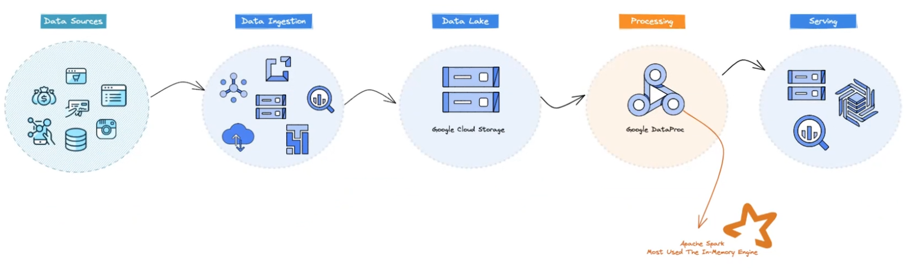
DataProc

Slide 11
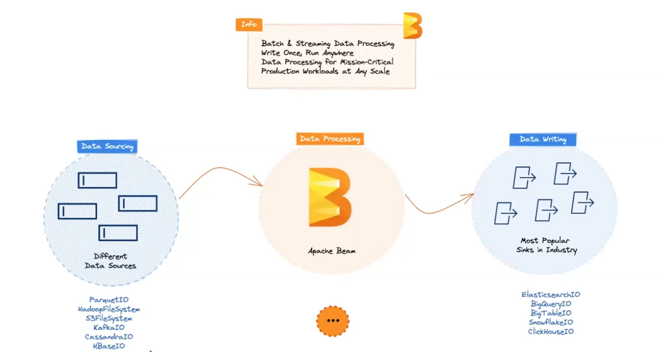
DataFlow

Slide 12
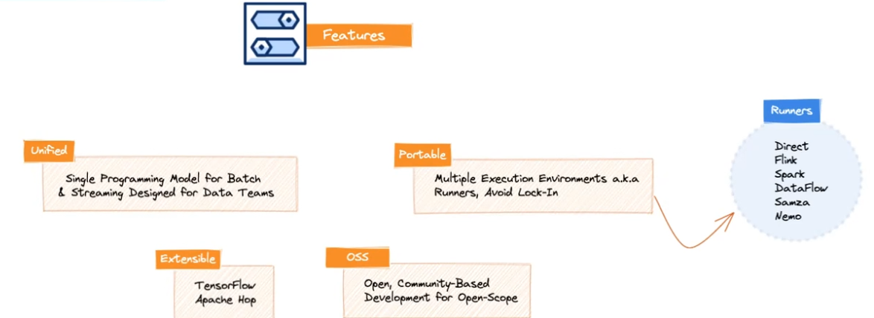
DataFlow

Slide 13
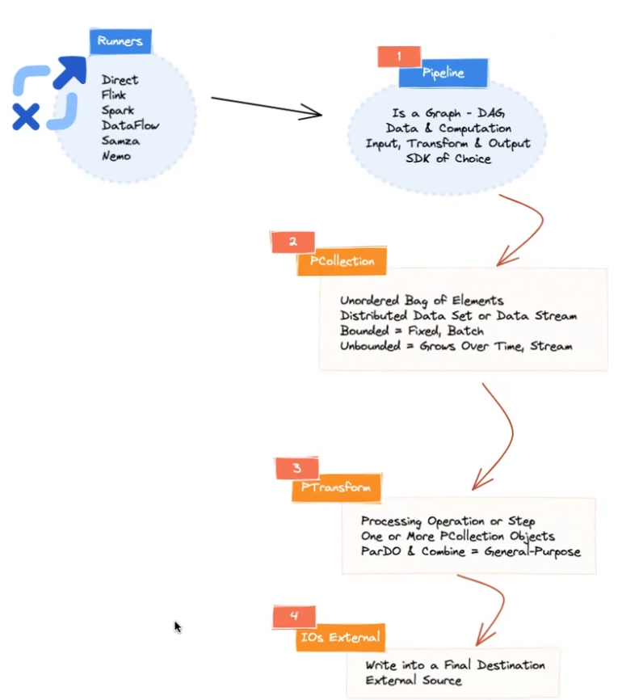
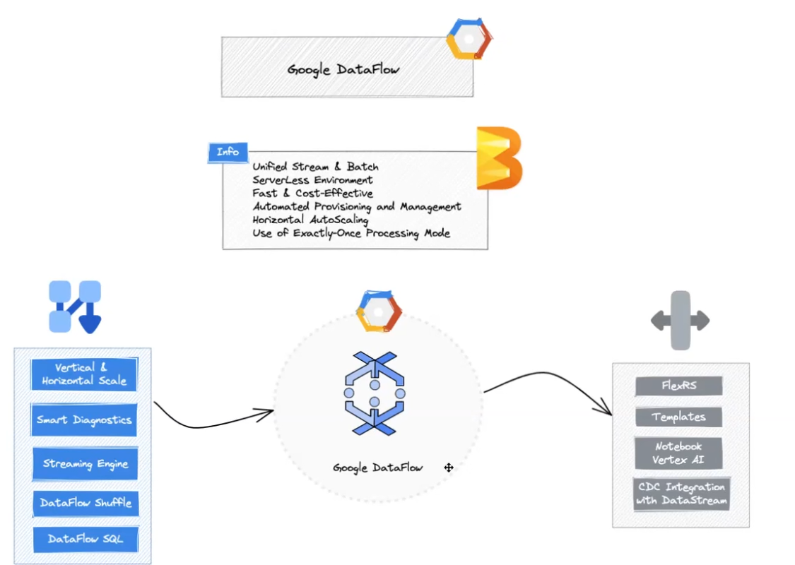
Dataflow

Slide 14
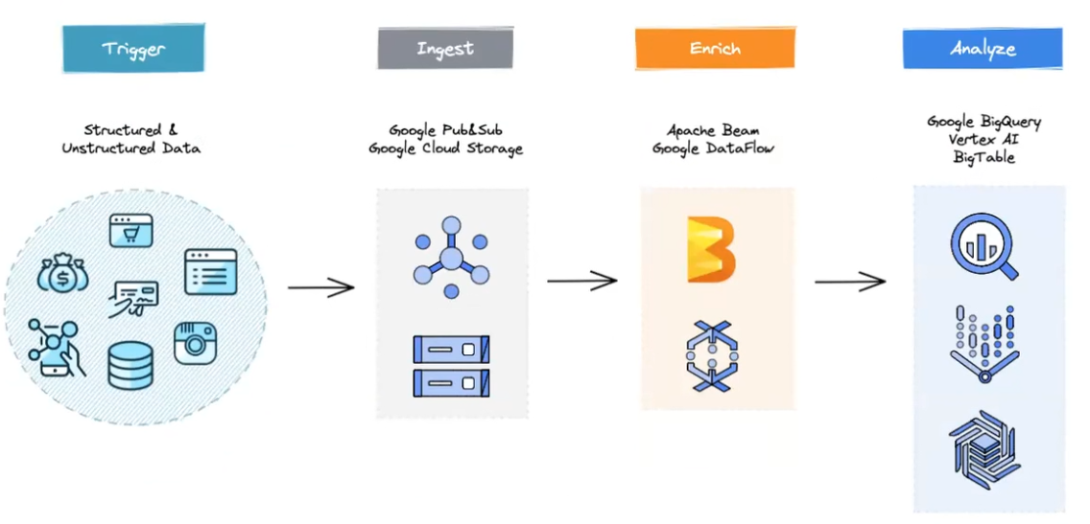
Dataflow

Slide 15
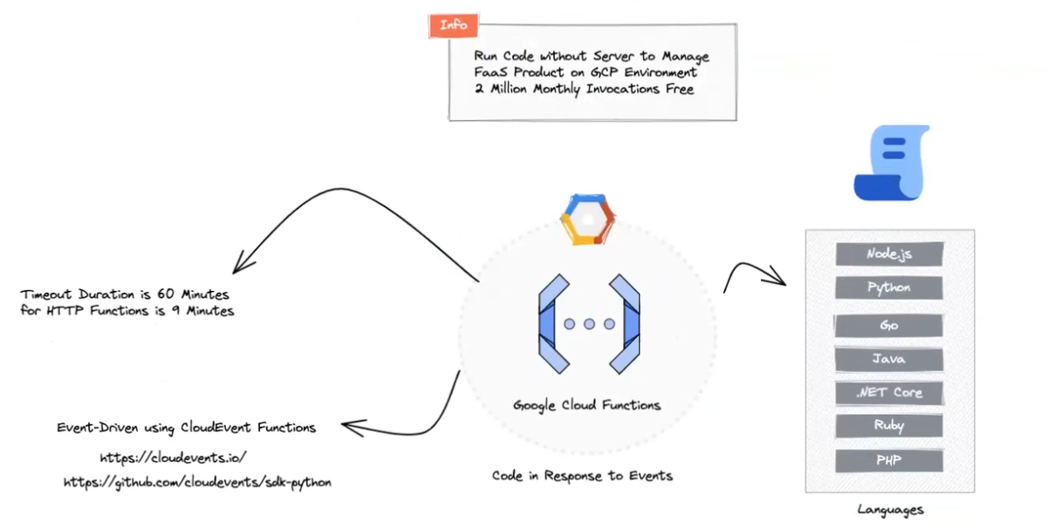
Cloud Function
FaaS
Mesmo que AWS Lambda e Azure Function
Reage a eventos

Slide 16
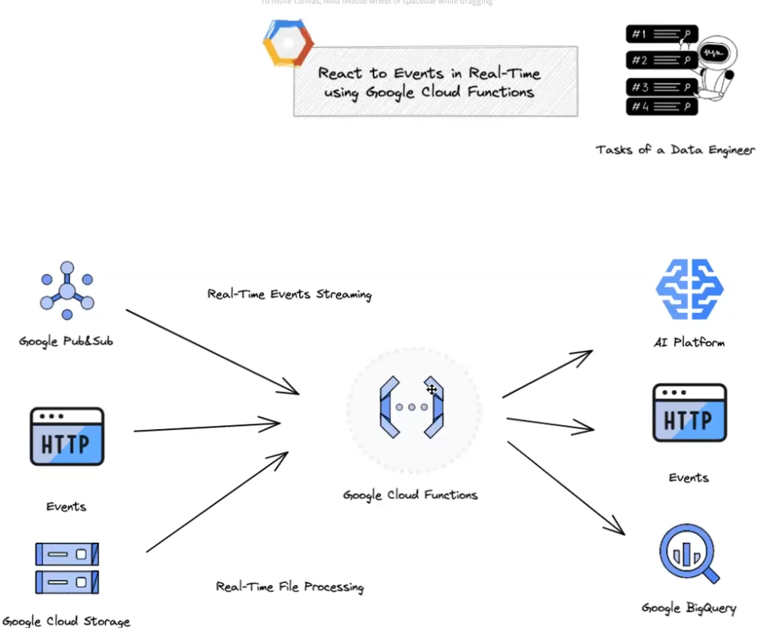
Cloud Function
Framework
Sample

Slide 17
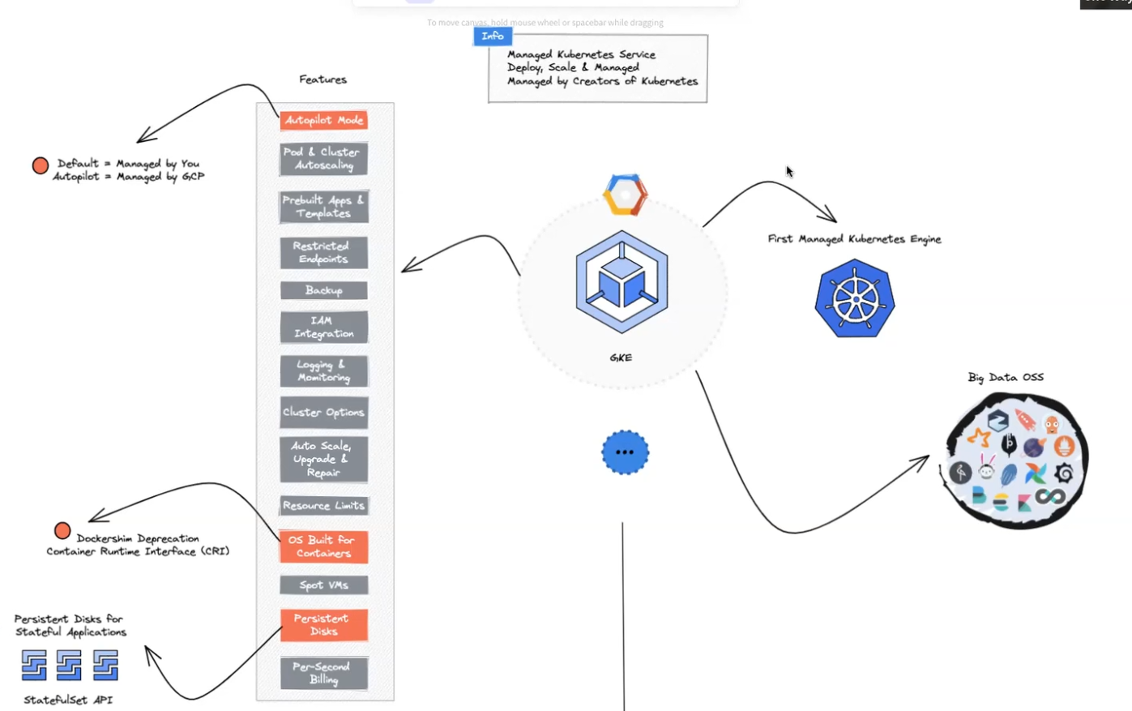

Slide 18
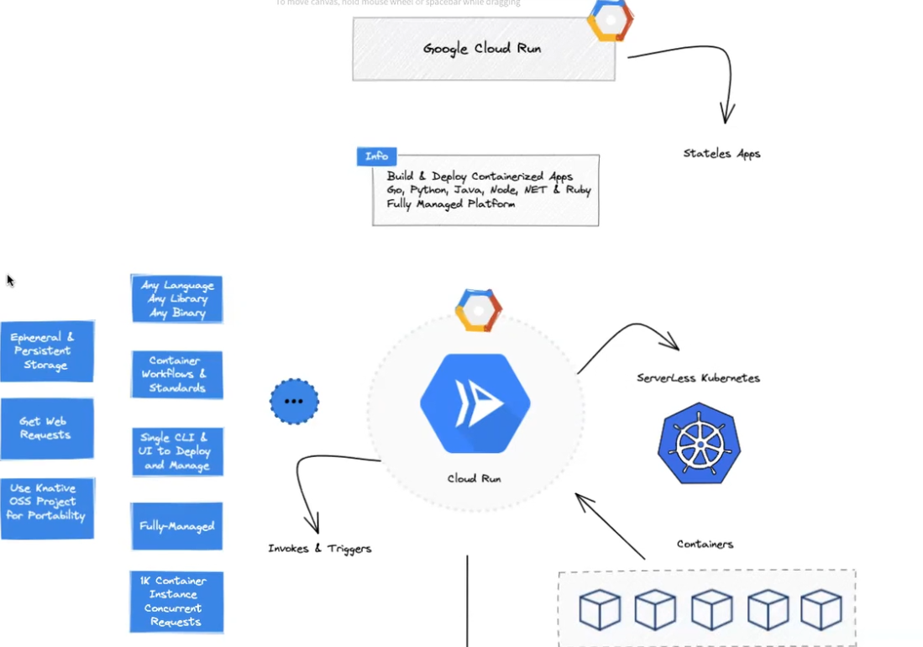

Slide 19
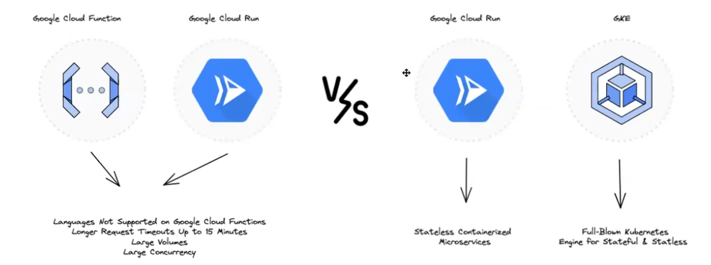

Slide 20
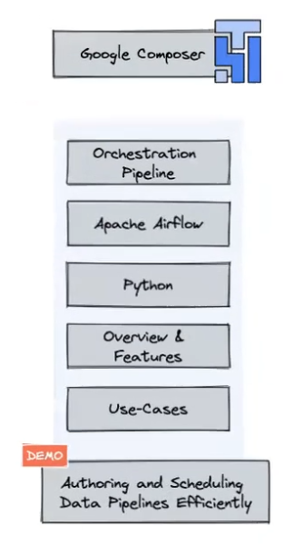
Composer
Kubernetes Autopilot com airflow

Slide 21
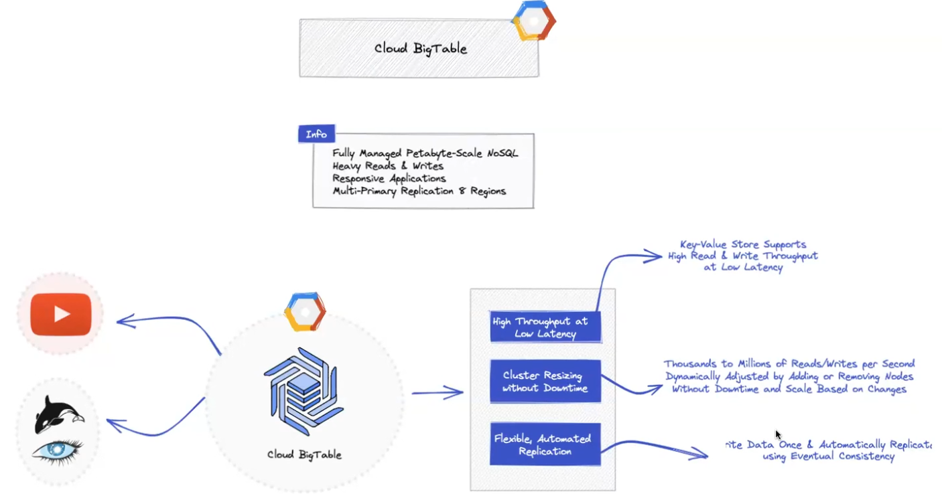
BigTable

Slide 22
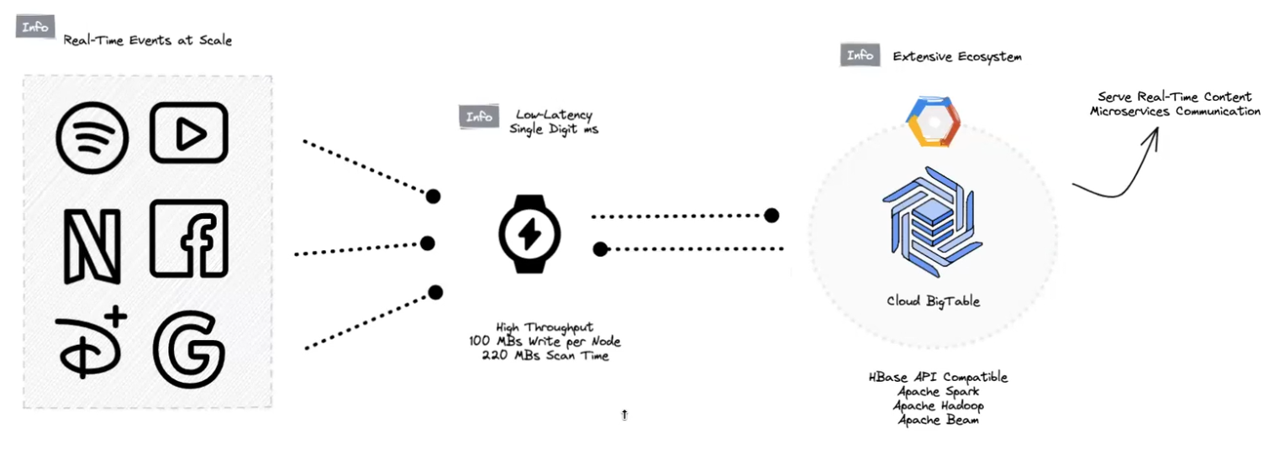
BigTable

Slide 23
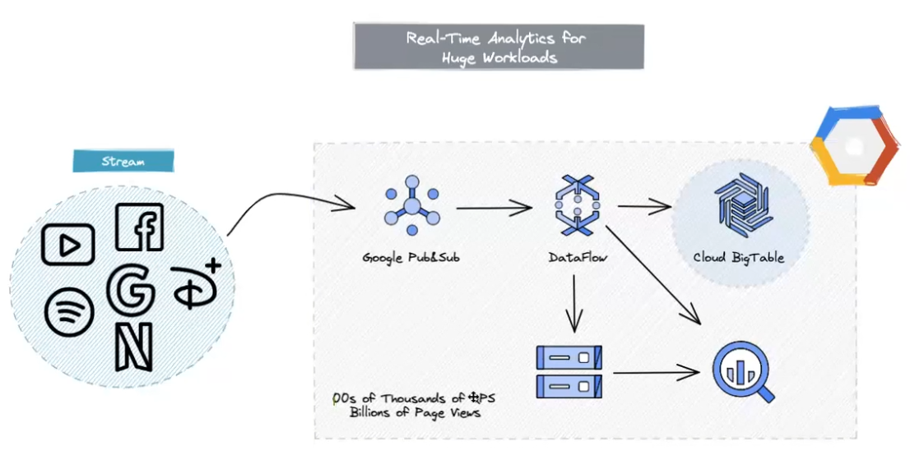
Big Table

Slide 24
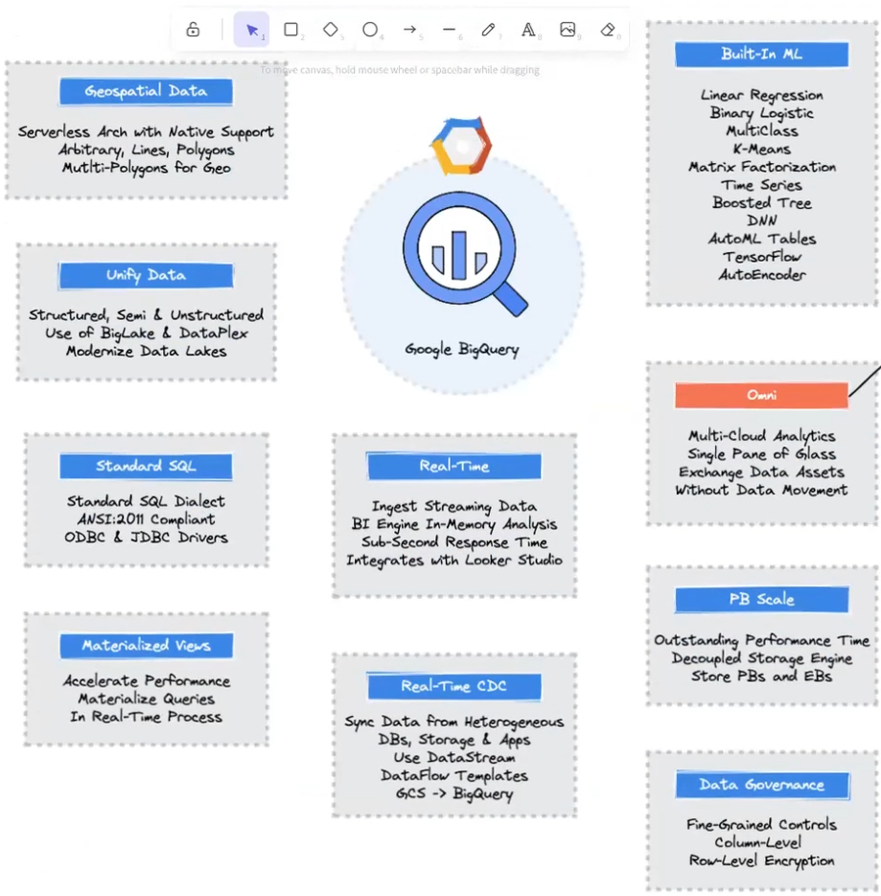
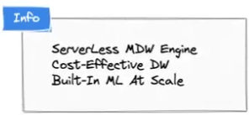
BigQuery & Omni
Habilitou Modern Data Stack
Separação de Storage e Computação

Slide 25
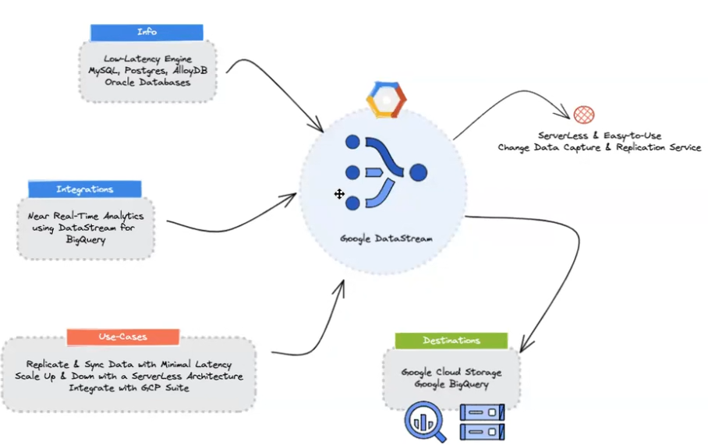
DataStream
Change Data Capture Serveless

Slide 26
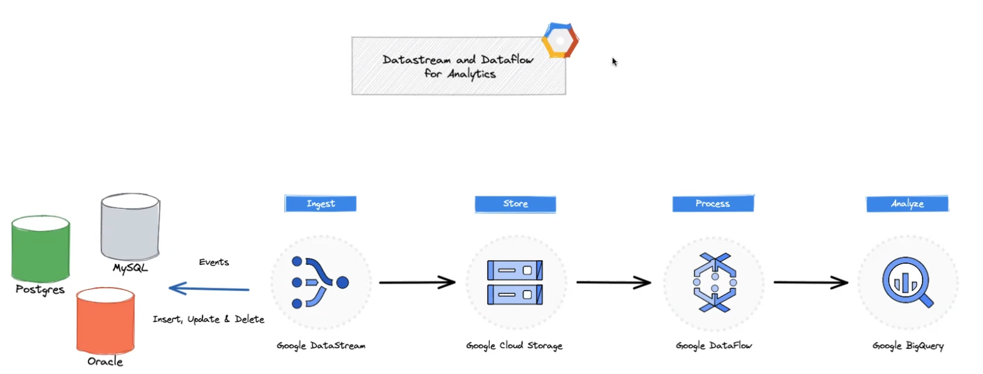
DataStream

Slide 27
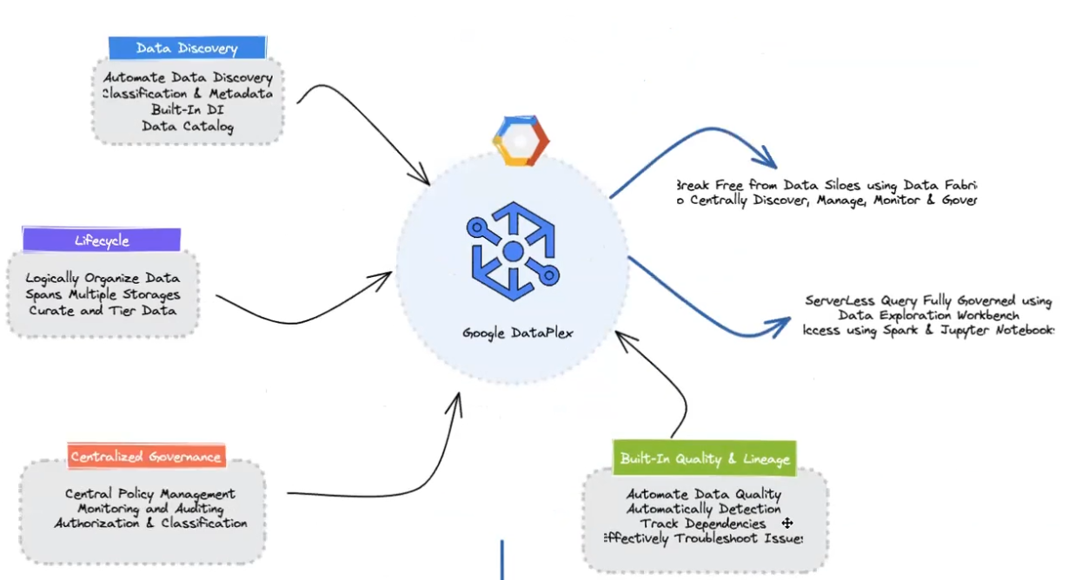
DataPlex
DataFabric
Data Lineage
Ambiente central de governança
Datamesh
Data discovery

Slide 28
Cloud Spanner
ACID in CAP
Possivel utilizer Postgresql API

Slide 29
AlloyDB
Compatible PostgreSQL
100x faster analytical queries than standard PostgreSQL
Serveless

Slide 30
Dataform
DBT like
Build scalable data pipelines with SQL

